Slide 1
Nursing Internship in the care chain
creating a different perspective of cooperation in healthcare between practice and education
Joyce Schipper, student – Kelly Posthumus, student – Anne-Mein Boerema, practical teacher – Erik Jansen, teacher Nursing School

Slide 2
Challenges in nursing
Demographic factors
Changing care environment

Slide 3
Aging: the problem
More elderly people (babyboomers)
Elderly people getting older
Less young people
Less young people that choose for a healthcare job

Slide 4
Changing care environment
Inpatient
Outpatient
Formal care
Informal care
Cure and care
Quality of life
Solitair
Network

Slide 5
Challenge for future care
More (critical) professionals needed
Other qualifications needed
Clinical Reasoning
Multidisciplinary approach
Evidence based practice

Slide 7
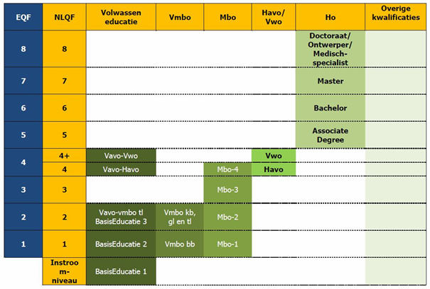

Slide 8
Change in nursing education
Untill 1997: in-service education: employee-based nursing
Education 2 levels: NLQF-4 and NLQF-6
Internship: 20 weeks, one ward or organisation, performance and automate
Knowledge and skills
Clinical pictures
Not much ‘self-steering’ regarding learning proces students
We need critical nursing professionals, but often we don’t educate them to be critical

Slide 9
Summing up…Why the importance of another type of internship in nursing
Healthcare is changing rapidly: less inpatient care, more outpatient care)
Quality Frameworks: need for more and qualified professionals
‘Beter leren in de zorg’ (Action programme ‘Working in Healthcare’ (Ministry VWS)
Increasing dependency of care chain partners
Knowing the possibilities of care chain partners
Triple aging, increasing complexity of elderly care
Outflow of professionals: 23% care professionals older than 55 years
Increasing need for bachelor nurses in elderly care
How to interest, bind and hold these students?
Educate (and work) in the care chain: the ‘Care Chain Internship’

Slide 10
Targets
Regarding students
More commitment to choose for elderly care
More selfcontrol over learning proces (critical professionals)
Less focus on medical problems, more focus on patientproblems and participationproblems
Regarding employees:
Acquaintance with the care organisations in the care chain (‘insight in continuity of care’)
Professionals in the ‘learning mode’ (life-long-learning by participating in learning community)
Regarding Care institutions
Learning communities (informal learning)
Interest, bind and hold (bachelor) nurses

Slide 13
Care chain internship as a solution?
Students do their internship in the care chain of the frailty elderly
Get them interested for the patientgroup
patientproblems and continuity of care central
‘Self-steering’ of the learning proces (learning outcoms are leading)
Care organisations in the care chain get acquinted (kijken ‘in de keuken’)
Learning Community / Community of Learners
Students, practical teachers, worksupervisor, teacher from nursing school
Learning organisations, learning employees (life long learning)
Informal learning

Slide 16
So….
More coöperation in the care chain
Decreasing number of days hospitalised
More attention for selfmanagement patiënt in home-situation
More elderly, elderly are getting older
More complex problems (functioning and participating)
Shift in mindset educating/training (bachelor) nurses
Educate nursing-students in the care chain
More ’self-steering’ during this education → critical professional attitude
Need for more (bachelor) nurses in elderly care (how to change this student mindset!)
Interest, bind en hold these students for the care of elderly

Slide 19
What is the care chain internship
Structure
Content
Experiences

Slide 20
Care chain | Week 1-6 | Week 8-13 | Week 15-20
Student(s) | Home care | Nursing home Revalidation | Hospital
Student(s) | Hospital | Home care | Nursing home Revalidation
Student(s) | Nursing home Revalidation | Hospital | Home care

Slide 21
Guidance in the Internship
Work supervisor
Student Teacher Nursing School
Practical teacher

Slide 22
If you let go
You’ve got two hands free….

Slide 23
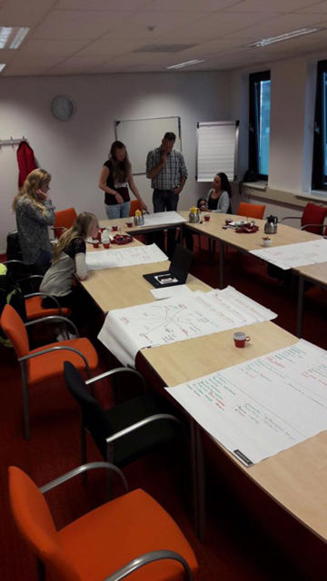
Learning Community
- learning with and from each other
- reflection, asking feedback,
innovation, share knowledge
- every 2/3 weeks
- 2 hours
- leadership from teacher, shared
leadership, personal leadership
- appointments

Slide 24
Weeks between the Internships

Slide 25
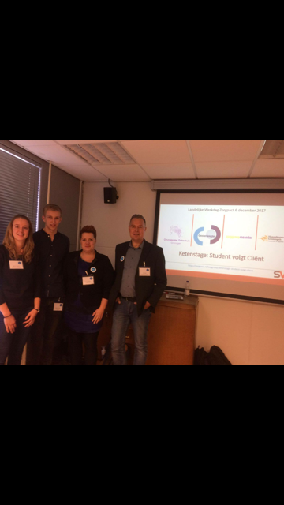
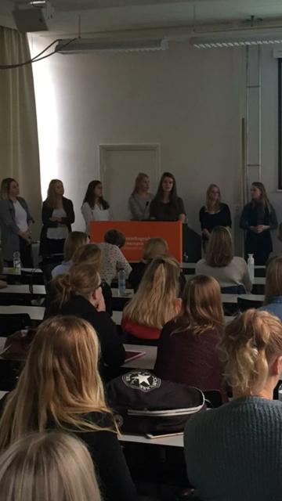
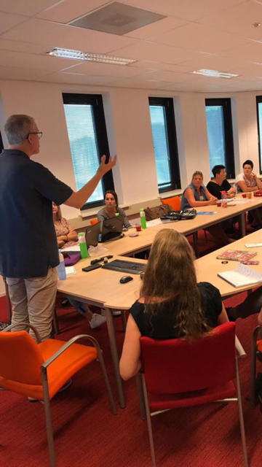

Slide 26
Intervision
Every 2 weeks
Only students from SVC
Personal development
Meta-reflection

Slide 27
Symposia

Slide 28
Experiences
Experiences from participating students

